Slide 1
Learning to balance fairness and self-interest: a reinforcement-learning account
Griffin M*, Lebreton M*, Gross J, & de Dreu CKW
Leiden University & University of Amsterdam

Slide 2



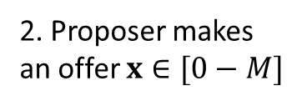
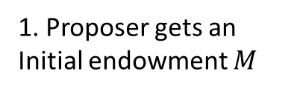
Fairness & Ultimatum game
Fairness can be ambiguous, e.g. in
different populations or
different contexts
where different fairness norms prevail, but no repeated-interactions with specific individuals
1. Proposer gets an Initial endowment $M$
2. Proposer makes an offer $x∈[0−M]$
3. Receiver makes a decision $A$ to Accept (1) or Rejects (0)the offer.
If Accepts:
P gets $M−x$
R gets $x$
If Rejects
P gets 0
R gets 0
Self-interest: keep $x$ as small as possible
keep enough of the endowment M
Fairness norm: make $x$ big enough
Morally acceptable
Offer do not get rejected

Slide 3
Hypotheses
When the fairness norm is ambiguous (e.g. interacting with individuals from different populations or in new contexts) individual can learn fairness norms by trial-and-errors, so as to propose offers that balance self-interest and compliance to norm.
To do so, individuals form expectations about the probability of individuals to accept offers, which are revised according to observed behavior, via prediction-error correction mechanism (a.k.a. delta-rule)
Prior norms, i.e. anterior to learning, bias learning, making individual sub-optimal in certain situations.
Learning is impacted by the social context, and knowledge about those contexts.

Slide 4


What is fairness?
Individuals in a population have (hard or soft) “threshold”, which determine whether they accept or reject an offer.
Fairness norm: make an offer that would be considered acceptable by “enough” individuals
Distribution of thresholds in a population
Cumulative distribution function
0.8
100
0.6
80
60
density
$$P(A)$$
0.4
40
Offer
0.2
20
Accept
Reject
0
0
0
5
10
15
20
0
5
10
15
20
Thresholds
Offers $x$

Slide 5
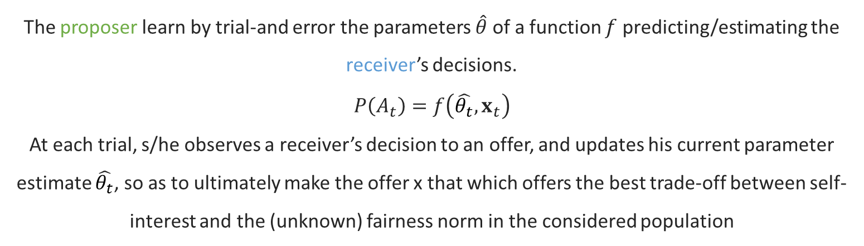
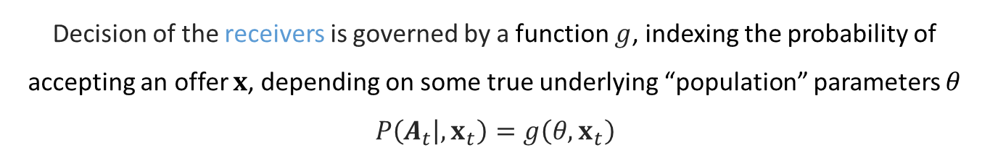
Core idea
Decision of the receivers is governed by a function $g$, indexing the probability of accepting an offer $x$, depending on some true underlying “population” parameters $θ$
$$P\left(A_{t} | ,x_{t}\right)=g\left(θ,x_{t}\right)$$
The proposer learn by trial-and error the parameters $\hat{θ}$ of a function $f$ predicting/estimating the receiver’s decisions.
$$P\left(A_{t}\right)=f\left(\hat{θ_{t}},x_{t}\right)$$
At each trial, s/he observes a receiver’s decision to an offer, and updates his current parameter estimate $\hat{θ_{t}}$, so as to ultimately make the offer x that which offers the best trade-off between self-interest and the (unknown) fairness norm in the considered population

Slide 6
Outline
Computational framework
Experimental framework (behavior)
Results: Experiment 1
Results: Experiment 2

Slide 7











Computational Framework: General
Estimated
Acceptance probability
Payoff matrix
Expected values of offers
20
100
12
$$P\left(A\right)=f(\hat{θ_{t}},x)$$
Choice Probabilities
$$P(A)$$
8
10
$$EV(x)$$
$$V(x)$$
×
$$P\left(x=x_{i}\right)$$
If accepted
If rejected
4
0
0
5
10
15
20
0
0
5
10
15
20
0
0
5
10
15
20
$$x$$
$$x$$
$$x$$
Update
$$\hat{θ_{t+1}}=f(\hat{θ_{t}}, …)$$
Agent
Environment
Obtained Outcome
Observed Decision
100
Action
$$R$$
$$A$$
$$P\left(A\right)=g(θ,x)$$
$$x$$
$$P(A)$$
Let’s take this step-by-step…
0
0
5
10
15
20
$$x$$

Slide 8









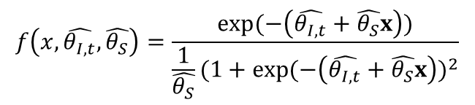

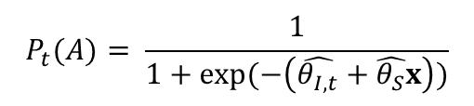


Estimated acceptance probability
Functional form: logistic function
Fixed and variable parameters
Interpretation (1)
$$P_{t}(A)= \frac{1}{1+exp⁡(−\left(\hat{θ_{I,t}}+\hat{θ_{S}}x\right))}$$
$\hat{θ_{I,t}}$: intercept at time $t$
$\hat{θ_{S}}:$ slope; fixed
Cumulative distribution function of the logistic distribution (~ normal distribution with heavier tails)
100
100
$$f\left(x,\hat{θ_{I,t}},\hat{θ_{S}}\right)=\frac{exp⁡(−\left(\hat{θ_{I,t}}+\hat{θ_{S}}x\right))}{\frac{1}{\hat{θ_{S}}}{(1+exp⁡(−\left(\hat{θ_{I,t}}+\hat{θ_{S}}x\right))}^{2}}$$
80
80
$\hat{θ_{S}}=1$
60
60
$$\hat{θ_{I,t}}=−9$$
$$P(accepted)$$
$\hat{θ_{S}}=1$
$$P(accepted)$$
$$\hat{θ_{I,t}}=−6$$
40
$$\hat{θ_{I,t}}=−9$$
40
$$\hat{θ_{I,t}}=−3$$
80
20
20
60
$\hat{θ_{S}}=1$
0
$$\hat{θ_{I,t}}=−9$$
0
5
10
15
20
0
0
5
10
15
20
$$\hat{θ_{I,t}}=−6$$
$$x$$
40
$$\hat{θ_{I,t}}=−3$$
$$x$$
20
Interpretation (2)
Norms ~ what can be expected to be accepted in a population distribution.
Formal but intuitive definition of fairness norm !!
0
0
5
10
15
20
$$x$$

Slide 9

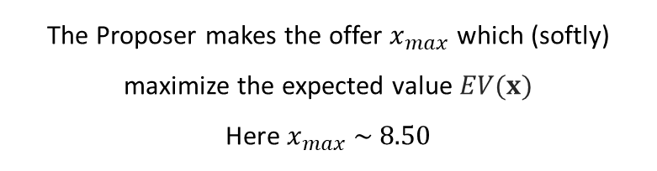

Expected value
Expected values along the offer-space
Expected value of an offer
20
100
Proposer makes an offer x and gets
$M−x$ if accepted
$0$ if rejected
Therefore, $∀x∈\left[0 M\right],$
$EV\left(x\right)=\left(M−x\right)P\left(A=1\right)+0∗P\left(A=0\right)$
$EV\left(x\right)=\left(M−x\right)P\left(A=1\right)$
With $P_{t}(A)= \frac{1}{1+exp⁡(−\left(\hat{θ_{I,t}}+\hat{θ_{S}}x\right))}$, (see preceding slide) we get
$EV\left(x\right)= \frac{M−x}{1+exp⁡(−\left(\hat{θ_{I,t}}+\hat{θ_{S}}x\right))}$
10
$$P(A)$$
$$V(x)$$
×
If accepted
If rejected
0
0
5
10
15
20
0
0
5
10
15
20
$$x$$
$$x$$
12
8
$$EV(x)$$
4
0
0
5
10
15
20
$$x$$
The Proposer makes the offer $x_{max}$ which (softly) maximize the expected value $EV(x)$
Here $x_{max} \sim 8.50$

Slide 10
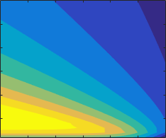





Intermediary: Deriving optimal policy
A bit of high-school math
Solution
We want to find x that maximize the expected payoff, i.e. argmax(EV(x))
$$∀x∈\left[0 M\right],EV\left(x\right)=\frac{M−x}{1+exp⁡(−\left(\hat{θ_{I,t}}+\hat{θ_{S}}x\right))}$$
To find the maximum, we need to find where $\frac{dEV\left(x\right)}{dx}=0;$
$\frac{dEV\left(x\right)}{dx}=\frac{−1×\left(1+\exp\left(−\left(\hat{θ_{I,t}}+\hat{θ_{S}}x\right)\right)\right)−(M−x)×(−b\exp\left(−\left(\hat{θ_{I,t}}+\hat{θ_{S}}x\right)\right))}{{(1+\exp\left(−\left(\hat{θ_{I,t}}+\hat{θ_{S}}x\right)\right))}^{2}}=0$
⇔ $−1×\left(1+\exp\left(−\left(\hat{θ_{I,t}}+\hat{θ_{S}}x\right)\right)\right)−\left(M−x\right)×\left(−\hat{θ_{S}}\exp\left(−\left(\hat{θ_{I,t}}+\hat{θ_{S}}x\right)\right)\right)=0$
⇔ $\exp\left(−\left(\hat{θ_{I,t}}+\hat{θ_{S}}x\right)\right)×\left(\hat{θ_{S}}\left(M−x\right)−1\right)=1$
⇔ $−\left(\hat{θ_{I,t}}+\hat{θ_{S}}x\right)+log\left(\hat{θ_{S}}\left(M−x\right)−1\right)=0$
⇔ $\hat{θ_{S}}M−\hat{θ_{S}}x−1+\log\left(\hat{θ_{S}}M−\hat{θ_{S}}x−1\right)=\hat{θ_{S}}M+\hat{θ_{I,t}}−1$
Solution from the Lambert W function:
$$\hat{θ_{S}}M−\hat{θ_{S}}x−1=W\left(exp\left(\hat{θ_{S}}M+\hat{θ_{I,t}}−1\right)\right)$$
$$x_{max}=\frac{\hat{θ_{S}}M−1−W(\left(exp\left(\hat{θ_{S}}M+\hat{θ_{I,t}}−1\right)\right)}{\hat{θ_{S}}}$$
(This is consistent with numerical approximation)
3
15
2
10
Slope ($\hat{θ_{S}}$)
Best Offer ($x_{max⁡}$)
1
5
0
0
-12
-8
-4
0
Intercept ($\hat{θ_{I,t}}$)

Slide 11



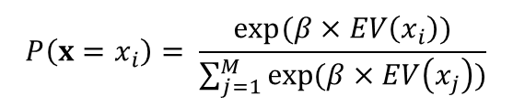





Choice function
Functional form: softmax function
multinomial logistic; transform expected values in offer probabilities
$$P\left(x=x_{i}\right)= \frac{exp⁡(β×EV\left(x_{i}\right))}{\sum_{j=1}^{M}{exp⁡(β×EV\left(x_{j}\right))}}$$
Interpretation
$β$: temperature parameter
Decision (inverse) noise
Also captures
Exploration/exploitation
Soft/hard-maximizers
12
80
10
60
$$β=0.25$$
8
$$β=1$$
$$EV(x_{i})$$
$$P(x=x_{i})$$
$$β=5$$
6
40
4
20
2
0
0
10
20
0
0
10
20
$$x_{i}$$
$$x_{i}$$

Slide 12





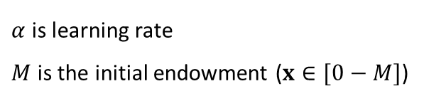





Updated rule
Update rule: delta rule
Observed Decision
Estimated probability of acceptance
$$A_{t}=\left\{\begin{aligned}1 if accepted \\ 0 if rejected\end{aligned}\right.$$
$$P\left(A_{t} | x_{t}, \hat{θ_{t}}\right)$$
Variations
Choice prediction error
$$θ_{I }$$
Asymmetric learning
$α^{+}$: learning rate after accepted
$α^{−}$: learning rate after rejected
$$δ_{t}=A_{t} − P\left(A_{t} | x_{t}, \hat{θ_{t}}\right)$$
100
Update of the acceptance probability function parameters (intercept)
80
60
$$accepted$$
$$P(A_{t}=1)$$
$$rejected$$
Choice / reward prediction errors
40
$$\hat{θ_{I,t+1}}=\hat{θ_{I,t}}+αMδ_{t}$$
20
$α$ is learning rate
$M$ is the initial endowment ($x∈[0−M]$)
0
0
5
10
15
20
$$x$$

Slide 13











Computational Framework: Reminder
Properties of the “environment”
Estimated
Acceptance probability
Payoff matrix
Expected values
20
100
12
$θ_{I}$: intercept of $g$
$θ_{S}$: slope of $g$
$$P\left(A\right)=f(\hat{θ_{t}},x)$$
Choice Probabilities
$$P(A)$$
8
10
$$EV(x)$$
$$V(x)$$
×
$$P\left(x=x_{i}\right)$$
If accepted
If rejected
4
0
0
5
10
15
20
0
0
5
10
15
20
0
0
5
10
15
20
$$x$$
$$x$$
$$x$$
Free parameters
Update
$\hat{θ_{I,0}}$: initial ($t=0$) intercept of $f$
$\hat{θ_{S}}$: slope of $f$
$β$: temperature of the choice function
$α$, or $α^{+}$and $α^{−}$ : learning rate(s)
$$\hat{θ_{t+1}}=f(\hat{θ_{t}}, …)$$
Agent
Environment
Obtained Outcome
Observed Decision
100
Action
$$R$$
$$A$$
$$P\left(A\right)=g(θ,x)$$
$$x$$
$$P(A)$$
0
0
5
10
15
20
Now we understand everything ☺
$$x$$

Slide 14







Computational Framework: Generative QC (1)
Generative QC:
Can the model generate the behavior of interest?
Can it learn, from various priors, true receiver acceptability function parameters?
Can it learn to ultimately make optimal offers, when faced with different receivers?
Environment: 3 receiver populations, with different acceptance probability function parameters
Simulations:
Assume
$\hat{θ_{S}}=θ_{S}=1$; (~ experimental data – see later)
Various levels of $\hat{θ_{I,0}}$
$β=5$ (~ experimental data – see later)
$α^{+}=0.25$ (~ experimental data – see later)
$α^{−}=0.10$ (~ experimental data – see later)
$$θ_{S}=1\text{;} θ_{I}=\{−9;−6;−3)$$
100
80
$$θ_{I}=−9$$
$$θ_{I}=−6$$
$$θ_{I}=−3$$
60
$$P(A)$$
40
20
0
0
5
10
15
20
$$x$$

Slide 15























Computational Framework: Generative QC (2)
Learning converges to the correct intercept whatever the initial belief
$$θ_{I}=−9;$$
$$θ_{I}=−6;$$
$$θ_{I}=−3;$$
0
10
0
10
0
10
-3
5
-3
5
-3
5
$$\hat{θ_{I,0}}$$
$$\hat{θ_{I,0}}$$
$$\hat{θ_{I,t}}−θ_{I}$$
$$\hat{θ_{I,0}}$$
$$\hat{θ_{I,t}}−θ_{I}$$
-6
0
-6
0
0
$$\hat{θ_{I,t}}−θ_{I}$$
-6
-9
-5
-9
-5
-9
-5
-12
1
5
10
15
20
24
-10
-12
1
5
10
15
20
24
-10
-12
1
5
10
15
20
24
-10
Trial ($t$)
Trial ($t$)
Trial ($t$)
Another view at the learning dynamics
0
0
0
$$θ_{I}=−9;$$
-2
-2
-2
$$θ_{I}=−6;$$
-4
-4
$$θ_{I}=−3;$$
$$\hat{θ_{I,t}}$$
$$\hat{θ_{I,t}}$$
-4
-6
-6
$$\hat{θ_{I,t}}$$
-6
-8
$$θ_{I}=−9;$$
-8
$$θ_{I}=−9;$$
-8
-10
$$θ_{I}=−6;$$
-10
$$θ_{I}=−6;$$
$$θ_{I}=−3;$$
$$θ_{I}=−3;$$
-10
-12
0
5
10
15
20
25
-12
0
5
10
15
20
25
-12
0
5
10
15
20
25
Trials
Trials
Trials

Slide 16












Computational Framework: Generative QC (3)
Learning therefore converges to the optimal offer whatever the initial belief
$$θ_{I}=−9; x_{Max}=11.07$$
$$θ_{I}=−6; x_{Max}=8.36$$
$$θ_{I}=−3; x_{Max}=5.60$$
0
15
0
15
0
15
-3
10
-3
10
-3
10
$$\hat{θ_{I,0}}$$
$$x$$
$$\hat{θ_{I,0}}$$
$$x$$
$$\hat{θ_{I,0}}$$
$$x$$
-6
-6
-6
5
-9
5
-9
5
-9
-12
1
5
10
15
20
24
0
-12
1
5
10
15
20
24
0
-12
1
5
10
15
20
24
0
Trial ($t$)
Trial ($t$)
Trial ($t$)

Slide 17
Computational Framework: Recovery QC
Recovery QC:
Can we identify different versions of the model (e.g. whether an individual uses symmetric vs asymmetric learning or choice vs reward prediction-errors)?
Can we recover the true value of free-parameters?
Estimation scheme:
Model comparison scheme:

Slide 18
Computational Framework: Recovery QC
Simulations: 4 models

Slide 19
Computational Framework: Conclusion
Comprehensive framework;
Produce behavior of interest
Estimable
=> allow fine-tuned hypothesis testing, and inferences about underlying computations

Slide 20
Experimental Framework
Creating different populations, with different norms

